Slide 1
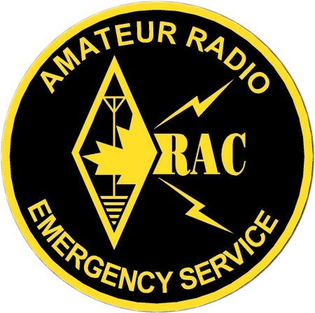
EMRG
Emergency Measures Radio Group
and
Ottawa ARES
Two Names - One Group - One Purpose
General Meeting - Jan 31, 2004

Slide 2
A
G
E
N
D
A
Introductions
EMRG Update
Exercise
Emergency Response
Group Exercise
Community Repeaters
Packet Radio

Slide 3
Emergency planning starts with YOU!
Emergency Management exists at all levels of Government
  Facilitate problem solving and resource acquisition for emergency response
  Monitor, plann and prepare (resource contacts, emergency plans, exercises) in times of no emergencies
City of Ottawa Emergency Measures Unit (EMU)
The City provides direct services, Fire, Police, EMS, Roads, Shelters, Water
Province Emergency Management Ontario (EMO)
Provides Province wide co-ordination, funding and field specialists
Minimal field resources (co-ordinators, not response workers)
Federal Public Safety & Emergency Preparedness
Canada (PSEPC)
Provides Canada wide & global co-ordination, funding, field specialists and the military
Minimal field resources (co-ordinators, not response workers)

Slide 4
Emergency Planning - More Than Response
Emergency planning identifies potential disasters that could happen in an area, then looks at;
the probability that each specific type of disaster can happen
options to reduce the likelihood of it happening
options to reduce the impact if it happens,
plans for how to respond if it does happen.
Example: Flooding may have a high probability in low lying areas.
Higher dykes or overflow channels can reduce the likely hood of it happening
Zoning plans that limit the type of use for low lying areas, such as for parks rather than homes can reduce the impact if it does happen
Plans identify where people will be evacuated to, how they get there and ensure there will be enough space and supplies if it does happen

Slide 5
The Role of EMRG In An Emergency
The role of EMRG in an emergency is to supply telecommunications support as part of the humanitarian effort in our communities, by providing radios & radio operators for organizations who;
  do not have a communications infrastructure (i.e. People Services, Red Cross, local citizen patrols)
  need a backup solution (i.e. Hospitals)
  need to to communicate with organizations who are on different communications systems (i.e. Red Cross, People Services, Salvation Army, Saint John Ambulance)
EMRG does not exist to back up the City’s radio system used by Police, Fire and Paramedics. We will give everything we have, if needed, but the capacity required is beyond the limits of what Amateur radio can supply.

Slide 6


EMRG Partners
EMRG partners with several organizations, BUT the City of Ottawa, Emergency Measures Unit is the primary partner. In the event that there are insufficient EMRG resources, EMU will assign priorities for EMRG.
E M R G
Secondary
Partners
Primary
Partner
City of Ottawa
EMU
H
People
Services
OFD
EMS
OPS
Individual Partnerships & Agreements
Ottawa Is Now One City With One Emergency Radio Group!

Slide 7
EMRG In The City Wide Picture
EMRG officially reports to the Emergency Measures Unit. But in an emergency, most EMRG activity will be co-ordinated directly with People Services.
First
Response
Limited Focused Activity
For Amateur Radio
First Response
Support
Main Relationship
For Amateur Radio
Emergency Management
Optional Area For Amateur Radio
Depending On Local Requirements
Hospitals & Other Special Services
such as Search & Rescue
Main Activity
For Amateur Radio
General Population Care

Slide 8
EMRG In The Amateur Community
EMRG is the interface between Amateur Radio & Emergency Agencies in Ottawa. Neighbouring Municipalities can request assistance directly through the City of Ottawa EMU, or through their local ARES group.
National
CANADIAN
RED CROSS
RADIO AMATEURS OF CANADA
OTTAWA BRANCH
NEIGHBORING ARES GROUPS
E
M
R
G
R
A
D
I
O
O
P
E
R
A
T
O
R
S
NO CLUB
Hospitals
CLUB
REPEATERS
L
I
C
E
N
S
E
D
VE2CRA
C
O
M
M
U
N
I
T
Y
OARC
S
E
R
V
I
C
E
City Of Ottawa
OVMRC
VE3TWO
EMU
PARC
VE3TEL
CPCARC
VE3MPC
MUNICIPALITIES
OUTSIDE THE CITY

Slide 9
Communications Requirements
Each EMRG partner has slightly different requirements, but the critical common component is the ability to provide communications across the City of Ottawa.
City of Ottawa
  Provide communications across Ottawa
  Provide communications with neighbouring municipalities
Red Cross
  Provide communications across Ottawa
  Provide communications with neighbouring municipalities
  Provide communications across the Province
Hospitals
  Provide communications between the hospitals in Ottawa, the EOC and EMS dispatch
  Provide communications with neighbouring hospitals in Eastern Ontario and Quebec

Slide 10
Getting Messages Through
The best method available should be used to send a message. This could be the telephone, fax, email, cell phone, Amateur Radio or a runner.
The “Best Method” offers clarity, reliability, accuracy and speed
Messages should be sent to the nearest location that can provide a better method of communications.
If phone service is out in the Eastern half of the City and a message is destined for Toronto, the best method for sending this message is to use FM voice or packet to get the message to a location in the West end of Ottawa and from there, phone or fax the message to Toronto

Slide 11
Challenges
There are two main challenges to providing communications across the City of Ottawa
Sealed Buildings - Concrete, Glass & Steel Boxes
  Radio communications is often difficult from inside with hand held radios or cell phones (especially from the centre of the building)
  There are few entrances (difficult to step outside to use the radio) and no way to run cables outside to an antenna.
  Hospitals are most challenging due to limits on radio power inside the building, access controls due to SARS.
Distance & Terrain
  Communities which are below or behind a major hill, making communications within the area and from the area back to the core of the City difficult.
  West Carleton is an extreme example, with Fitzroy Harbour, Constance Bay and Carp all on different sides of hills, plus significant distance back to central Ottawa.

Slide 12
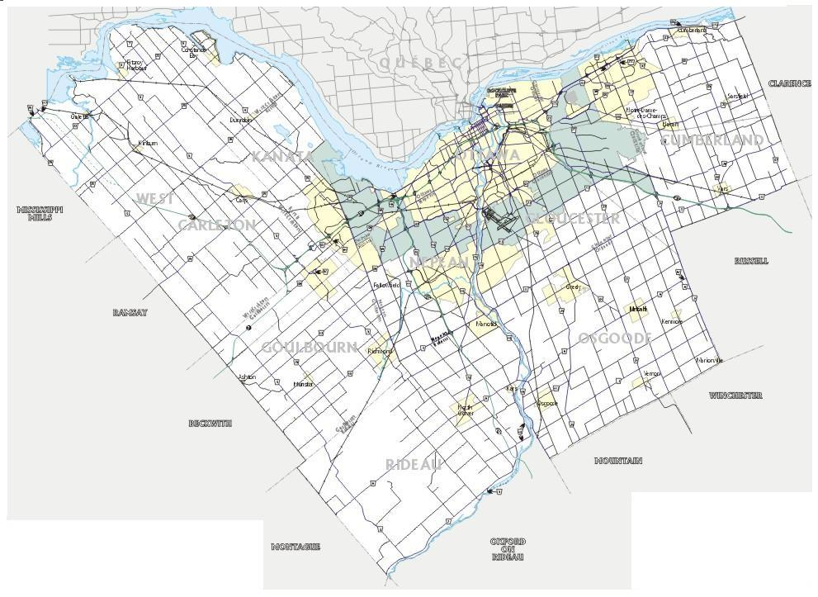
Ottawa is a large City!
Renfrew
ARES
Quebec
A
Prescott
& Russell
ARES
C.
RC.
H
H
.R
B
A
OTTAWA
Lanark
ARES
Stormont
Dundas
Gelngary
NO ARES
110 km by road
85 km by air
C
A
B
Leeds
Grenville
ARES
50 km by air
A
City
Hall
35 km by air
B
50 km by air
C

Slide 13
First 24 Hours Is Critical
Amateur radio can make its greatest impact in the first 24 to 48 hours of a disaster while information is being gathered, decisions are being made and normal communications systems are damaged or inoperable.
Planning and Practice help ensure that Amateur radio can be activated and deployed as quickly as possible
Within 24 to 48 hours of a disaster, commercial backup systems will be deployed to replace or increase existing communications capabilities, relieving some of the communications pressures.

Slide 14
How Many Amateurs Is Enough?
What To Do If There Aren’t Enough?
Quality Vs. Quantity?

Slide 15
How Many Amateurs Are Required?
The exact number of amateurs available and required in an emergency cannot be predicted or planned. Amateurs are volunteers and family comes first!
Effective communications requires a lot of people!
With 2 amateurs per location and 3 shifts of 9 hours per day, each location will require 6 amateurs per day
  Simple Evacuation:
    EOC + Red Cross + NCS + 2 shelters = 30 amateurs per day
  Hospital Back Up:
    EOC + Montfort + CHEO + General + Civic + Heart Institute + EMS Dispatch + QCH = 48 amateurs per day
The 9 hour shift includes 8 hours on duty plus 30 minutes before the shift to get briefed plus 30 minutes after the shift to complete any paperwork.

Slide 16
Managing Resource Expectations
Amateurs feel a duty to provide emergency communications
There is a misbelief that all amateurs share a sense of duty or responsibility to provide communications for community events or in an emergency. The reality is that only a subset of amateur radio that feels this sense of duty!
There are Hundreds of Amateurs in Ottawa to help
“Ottawa has 2000 amateurs” (Recent SUN newspaper article)
That is really 2000 call signs, which reduces to around 1400 amateurs once club and duplicate callsigns are removed
In Ottawa there are less than 200 amateurs who do all the community service and emergency service work.

Slide 17
The Untrained Volunteer
Amateurs have always said, that in an emergency there will be plenty of Amateur volunteers. They will come out of the woodwork to help when they are really needed!
How To Use Untrained Amateur Radio Volunteers
  Don’t know where to go
  Don’t know who is in charge
  Can’t be placed in secure sites
  Skills, equipment and attitude are unknown
Some jurisdictions now say “Send Them Home”!

Slide 18
EMRG Response Plan
The EMRG plan for managing resources in an emergency, is to ensure there is a skilled core group, who can organize, manage and partner with Amateurs who come to help in an emergency!
Do we have enough people for a core group?
Are there more Amateurs in Ottawa who would like to participate in EMRG if they knew more?
How do we find interested amateurs, inform them and get them involved?

Slide 19
Group Exercise
Based on what we discussed today and what you know from experience, as a group, find at least 1 answer for each of the following questions
Why do YOU participate in EMRG?
Why do more Amateurs NOT participate in EMRG?
What does EMRG do best?
What does EMRG do worst?
What are you willing to do to make EMRG better?

Slide 20
Community Repeaters
Designed to provide portable and mobile coverage in the local area, to support activities
such as Shelters and Citizen Patrols
Located on antennas which were formerly Ottawa Fire Dept radio sites.

Slide 21
Radio Coverage Across Ottawa
OTTAWA

Slide 22
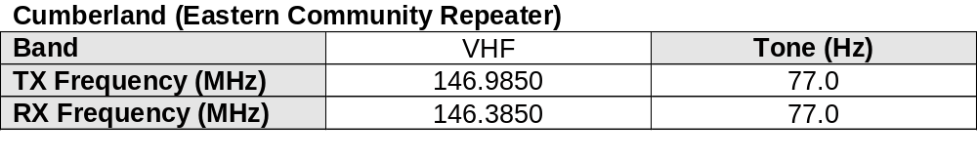
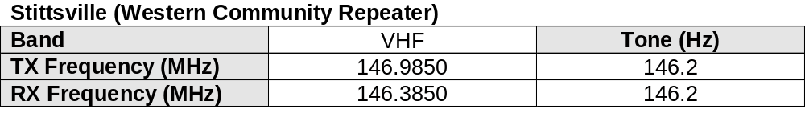
East & West Repeaters
Community Repeaters
Designed to provide portable and mobile coverage in the local area
Same frequency across the City
CTCSS Tone on Input & Output
Use different CTCSS at each site

Slide 23
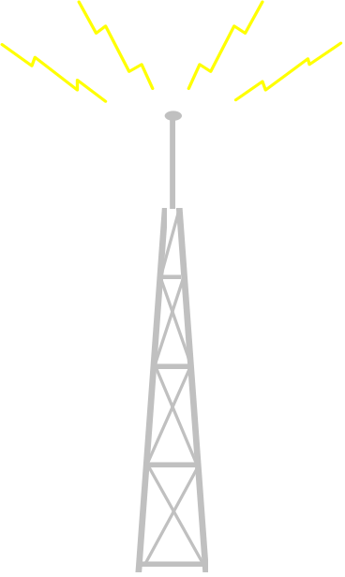

CTCSS Tones Required
CTCSS Input & Ouput tones are required to ensure that a user, within range of both repeaters, only activates the repeater they want.
If the Cumberland repeater was being used locally, they may experience interference, if the signal from the mobile, is as strong as the signal from the local users.
Stittsville
Decode 146.2 kHz
Encode 146.2 kHz
Cumberland
Decode 77.0 kHz
Encode 77.0 kHz
Mobile radio transmits with 146.2 kHz Tone
Only one repeater will activate

Slide 24
Packet Radio

Slide 25
www.emrg.ca

